Slide 1


Sponsored Programs Administration Resource & Knowledge Series
REGULATORY COMPLIANCE
Presented by:
Joanne Muratori, Janice Turchin, Suhail Pantajos
Renea Carver, Jose Vazquez Perez, Mike Miller

Slide 2


General Business
Cell Phones Off
Sign In
REGULATORY COMPLIANCE

Slide 3

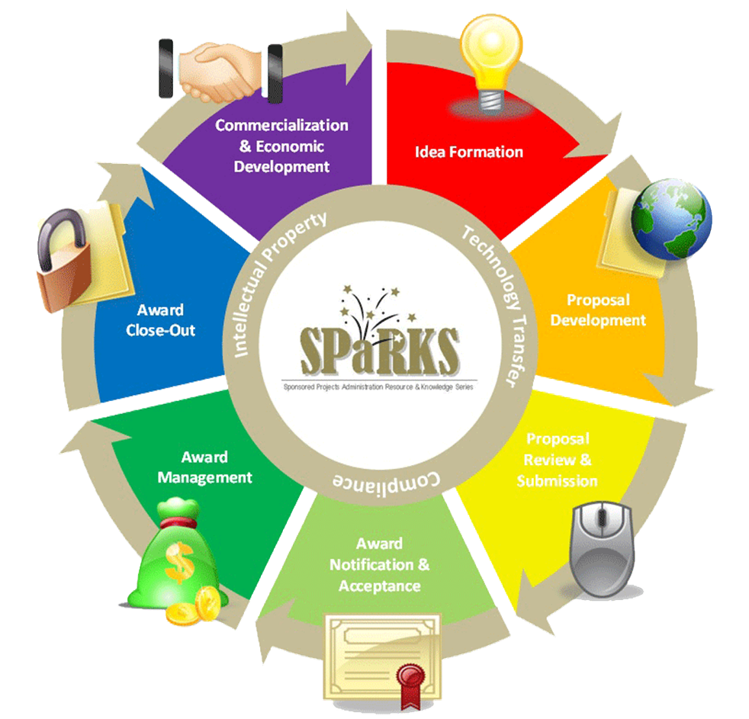
Exploring Research Administration from Concept to Commercialization

Slide 4
Exploring Research Administration from Concept to Commercialization
INSTITUTIONAL REVIEW BOARD
(IRB)
Joanne Muratori, Janice Turchin

Slide 5
IRB Overview
Sophia Dziegielewski, Ph.D.
IRB Chair
IRB Office Staff:
Joanne Muratori, IRB Coordinator, MA,CIM
Patria Davis, IRB Coordinator, MSP
Felicea Van, Office Assistant
REGULATORY COMPLIANCE

Slide 6
IRB Function
The purpose of an IRB is to review research involving human subjects to ensure their rights and welfare are adequately protected.
REGULATORY COMPLIANCE

Slide 7
Why Do Human Research Subjects Need Protection?
Trigger Events -The Nazi Experiments -Tuskegee Syphilis Study
Ethical Milestones -Nuremberg Code 1947 -National Commission for the Protection of Human -Subjects Biomedical & Behavioral 1974 -Belmont Report 1978 -Common Rule 1991
REGULATORY COMPLIANCE

Slide 8
Ethical foundations
1974- Belmont Report
Represents 3 underlying principles
Respect for persons
Beneficence
Justice
REGULATORY COMPLIANCE

Slide 9
Federal regulations
1974 National Research Act
1974- 45 CFR 46
1981- 45 CFR 46 revised, 21 CFR 50, 21 CFR 56
addresses consent and role of IRBs
1991- “The Common Rule”
REGULATORY COMPLIANCE

Slide 10
Protective mechanisms established by “The Common Rule”
Institutional assurances of compliance
Review of research by an IRB
Informed consent of subjects
REGULATORY COMPLIANCE

Slide 11
Institutional Assurance
UCF has negotiated with the Office for Human Research Protections that all of the institution’s human subject research activities, regardless of funding, will be guided by the Belmont Report, will comply with the Common Rule, and other regulations as applicable.
This is referred to as a
Federalwide Assurance (FWA).
REGULATORY COMPLIANCE

Slide 12
Why is compliance important?
Professional ethics
Statute compliance
Publication
Individual grant funding
University grant funding
University research
Liability
REGULATORY COMPLIANCE

Slide 13
UCF has received accreditation of its Human Research Protection Program
Accreditation by the Association for the Accreditation of Human Research Protection Programs, Inc. (AAHRPP) is the “gold standard” that signifies that UCF is in full compliance with regulatory requirements as well as industry best-practices.
Analogous to Association for Assessment and Accreditation of Laboratory Animal Care International (AAALAC International) accreditation for animal research.
Demonstrates commitment to human subject protections
REGULATORY COMPLIANCE

Slide 14
AAHRPP accreditation offers benefits to researchers
Better standing in competition for funding.
Many foundations give preference to accredited institutions (CF, alpha1)
Recognition of importance by government and private sponsors
Required by VA, DOE
NIH intramural program beginning to work towards AAHRPP accreditation
Easier collaboration with other accredited organizations (i.e. Veterans Administration Hospitals)
REGULATORY COMPLIANCE

Slide 15
How do I know if a project needs IRB review?
Meets federal definition of “research”
Systematic investigation designed to develop or contribute to generalizable knowledge
Meets definition of “human subject(s)”
The investigator will gather data about living individuals through intervention or interaction OR The investigator will gather data about living individuals that is private AND identifiable.
REGULATORY COMPLIANCE

Slide 16
Criteria for IRB Approval
Risks are Minimized (Consistent with a sound research design and does not unnecessarily expose subjects to risk)
Risks are Reasonable in Relation to Benefits
Selection of Subjects is Equitable
Informed Consent will be Sought for Each Prospective Subject
Informed Consent will Be Documented
Research Plan Adequately Provides for Monitoring the Data Collected to Ensure Safety of the Subjects
Research Plan Adequately Protects the Privacy of Subjects and Maintains Confidentiality
When some or all of the subjects are likely to be vulnerable to coercion or undue influence, additional safeguards need to be included in the protocol to protect the rights and welfare of these subjects.
REGULATORY COMPLIANCE

Slide 17
IRB Review of Research
All research projects are categorized into one of three categories for the IRB review process. Each category is different in the level of scrutiny and submission procedures. The IRB is responsible for making the final decision of which category a research project falls under.
Full Board Review
Expedited
Exempt
REGULATORY COMPLIANCE

Slide 18
Levels of review- Expedited (reviewed by Chair or IRB designated member)
Minimal risk and fit into an “Expedited” category
Document review
Surveys or interviews
Collection of specimens
Routine noninvasive procedures
REGULATORY COMPLIANCE

Slide 19
Minimal Risk Definition
Minimal risk is the probability and magnitude of physical or psychological harm that is normally encountered in the daily lives, or in the routine medical, dental, or psychological examination of healthy persons.
REGULATORY COMPLIANCE

Slide 20
Full Board Protocol Review
Protocols which meet the definition of more than minimal risk
PI is invited to meeting to clarify IRB concerns
UCF IRB meets once a month
REGULATORY COMPLIANCE

Slide 21
The IRB has the authority to:
Approve
Require modifications prior to approval
Table until major issues are clarified
Disapprove all research activities including proposed changes in previously approved human subject research.
REGULATORY COMPLIANCE

Slide 22
Required Training
CITI online human subjects protection training is required every 3 years. Study will not be approved until all KSP are trained.
See the UCF IRB website for access
REGULATORY COMPLIANCE

Slide 23
Institutional Review Board
IRB
Research Involving Human Participants
University of Central Florida
Office of Research & Commercialization
407-823-2901 or fax 407-823-3299
www.research.ucf.edu/Compliance/irb.html
Regulatory Compliance

Slide 24

QUESTIONS ?
REGULATORY COMPLIANCE

Slide 25
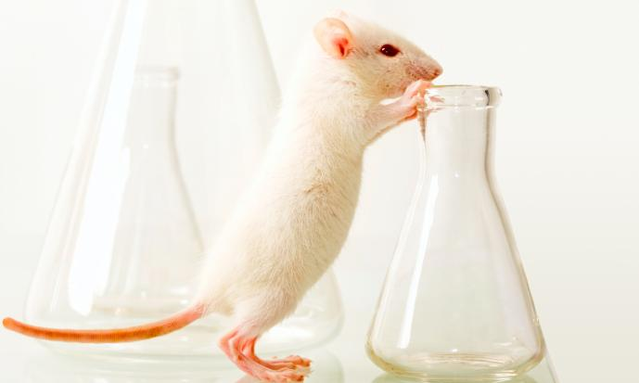
Exploring Research Administration from Concept to Commercialization
INSTITUTIONAL ANIMAL CARE AND USE COMMITTEE
(IACUC)
http://www.research.ucf.edu/Research/IACUC_ARPO.html
Presented by:
Suhail Pantojas, IACUC Coordinator
Notes:
How many people present are involved on animal research
Animal Research Protection Office & today I’ll be talking to you about the IACUC which is the committee of our program

Slide 26
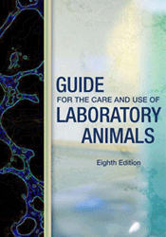

IACUC
What is IACUC?
IACUC refers to the Institutional Animal Care and Use Committee, a federally mandated committee. The overall role of the IACUC is to oversee and evaluate all aspects of the Institution’s animal care and use, ensuring the proper care and welfare of animals involved in research.
Institutional Animal Care and Use Committee
Required by federal law and PHS policy
Animal Welfare Act
Public Health Service
Guide for the Care and Use of Laboratory Animals
Applies to all teaching and research involving vertebrate animals.
Regulatory Compliance

Slide 27
IACUC
The UCF IACUC is composed of 6 regular voting members (two of which are Veterinarians), a non-affiliated voting member, a non-scientist voting member, 4 alternate voting members, and 5 ex-officio members. The IACUC meets bi-monthly to review and discuss protocols.
Main goal is to review all protocols involving live vertebrate animals, and assure animal welfare and well-being within our institution and facilitate our researchers compliance with all regulatory agencies.
All vertebrate animal use, including field studies, conducted by University faculty, students, or staff, or supported by University funds, must be reviewed and approved by the IACUC prior to the initiation of that activity that will be conducted, regardless of where it will be performed.
Regulatory Compliance
Notes:
*Two of our members are Veterinarians.
27

Slide 28
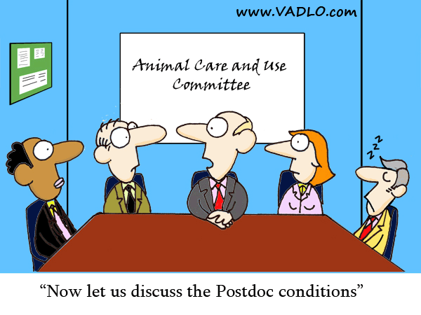
IACUC
Regulatory Compliance
Notes:
28

Slide 29
Institutional Animal Care & Use Committee
(IACUC) Functions
Principal
Investigators
Approval Letters
Complaints
Community &
Public Interests
Inspections of Labs
IACUC
Regulators:
USDA
OLAW
NIH / PHS
FDA, NSF, etc.
Occupational Health
Animal Contact
Training
Accreditation
Organizations

Slide 30
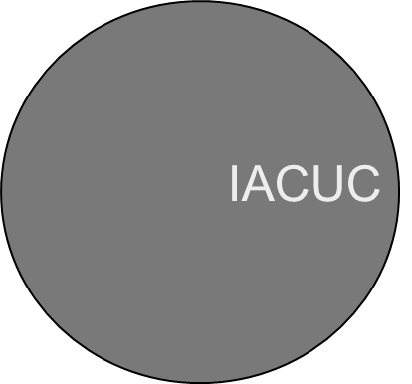
IACUC
Animal Care and Use Program Components
AV & Staff
IO &
Administration
Each component must make its contribution so that the whole is greater than the sum of the parts.
Investigator
Regulatory Compliance

Slide 31

IACUC
Responsibilities of the IACUC
At least once every 6 months, review the research facility's program, inspect all of the animal facilities, including animal study areas/ satellite facilities, using USDA Regulations & The Guide as criteria.
Prepare reports of IACUC evaluations and submit them to the Institutional Official (IO)
Review and investigate legitimate concerns involving the care and use of animals at the Research Facility resulting from public complaints or from reports of non- compliance with PHS policy received from facility personnel or employees. Serious or continuing non-compliance must be reported to the Office Laboratory Animal Welfare (OLAW).
If noncompliance with PHS Policy is verified, the activity will be suspended; take corrective action and report to funding agency and USDA.
Regulatory Compliance
Notes:
31

Slide 32

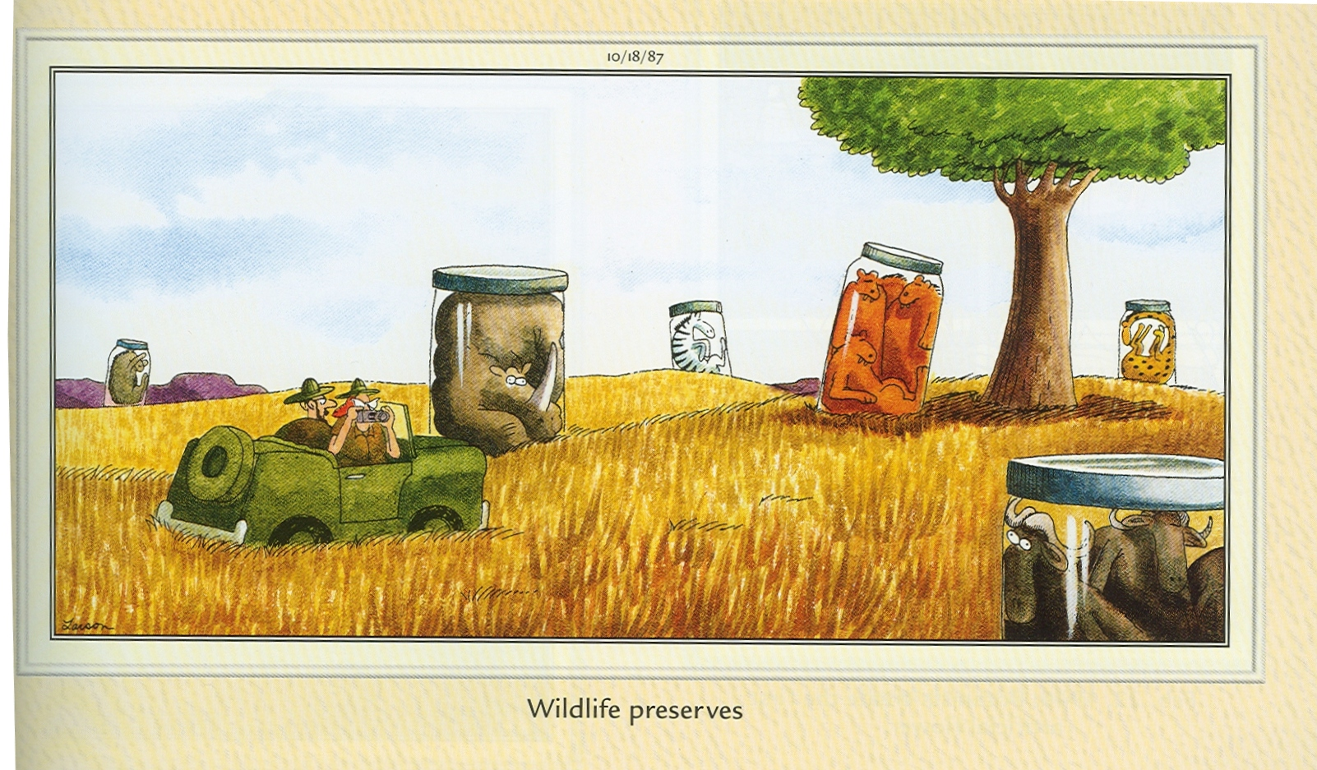
Regulatory Compliance

Slide 33
IACUC
IACUC ACTIONS
Full Approval is given when the submitted protocol meets ALL of the committee’s requests and requirements.
To Table or Withhold Approval is an option when a submission does not meet basic requirements or acceptable standards.
Suspension can occur when a researcher is found to be in serious violation of methods previously approved by the committee.
Regulatory Compliance

Slide 34
IACUC
What are the methods of protocol review?
Only two methods can be used to review protocols for:
Initial review
Significant changes
Continuing review
Full committee review
Designated member review
Administrative review may be used to approve minor changes

Slide 35
IACUC
What are the differences?
Full Committee Review (FCR)
Convened meeting of a quorum (face to face)
May request for modifications, approve or disapprove
Simple majority vote
Designated Member Review (DMR)
Two qualified members of the committee to review
All members are provided with the protocol for review and may request a FCR within a specified time period
They may request modifications, approve or disapprove

Slide 36
IACUC
Reporting concerns for animal welfare
All claims made will be taken seriously and investigated by the IACUC committee.
No individual shall be discriminated against or be subject to any reprisal for reporting violations of regulations or standard.
*Anonymity Guaranteed
It is UCF policy that individuals reporting knowledge of improper animal use or concerns related to animal use and welfare at UCF are protected by the Whistleblower Act.
Regulatory Compliance

Slide 37


IACUC
Full Accreditation
June 2011
Association for Assessment and Accreditation of Laboratory Animal Care
Regulatory Compliance
Notes:
37

Slide 38

IACUC
COMING SOON!!!!

Slide 39
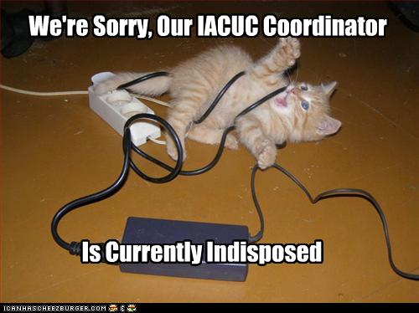
IACUC

Slide 40
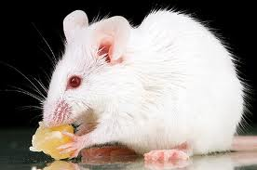
Questions?
? ? ? ? ? ? ? ?
Regulatory Compliance

Slide 41

Exploring Research Administration from Concept to Commercialization
EXPORT CONTROL
Mike Miller
Assistant Director for Export Controls

Slide 42

Objectives
Identify, instruct and guide SPARKS students on appropriately managing export control issues encountered in the university environment.
1
Overview of Export Controls Regulations, Exports & Deemed Exports; Controlled Articles, Technical Data & Services
2
Identifying Export Controlled Research Identifying and negotiating export controlled projects

Slide 43

History
U.S. law,
policy,
tariff,
trade obligation,
foreign policy obligation, economics,
crime control,
anti-terrorism,
non-proliferation,
regional stability,
short supply,
national security, embargoes,
sanctions,
practices (human rights, etc) chem/bio agents,
encryption,
firearms,
missile tech,
surreptitious listening, military technology
The reason controls exist:
To facilitate the sharing of U.S. origin military technology with allies and nations whose interests coincide with those of the United States while…
Denying military technology to any country that could be detrimental to U.S. security interests.
Implementing foreign policies
Preventing terrorism, proliferation of WMD,
Fulfilling multilateral obligations (UN sanctions, Wassenaar Arrangement, NAFTA, etc.)
Practices, end-users, end-use
From the Federation of American Scientists:
http://www.fas.org/nuke/control/export/provisions.htm
Department of Commerce, “Basis of CCL Controls”
http://www.bis.doc.gov/policiesandregulations/basis_of_ccl_controls.htm

Slide 44
“Structural Equation Model” of Export Controls
“When we understand that slide, we’ll have won the war!”

Slide 45

University Export Compliance
Complicating Factors in the University Environment
Decentralized structures
Limited resources
Highly detailed process to determine controls
Compels researchers away from controlled research – they don’t want the burden
Conflicts with traditional belief of “academic freedom” – doesn’t make sense in the educational environment
Limits educational experience
Compliance Burden:
Responsible for all of CCL and USML, plus FACR and trade sanctions
Foreign nationals possible from every country in the world
Particularly with emerging technologies, the regulatory landscape is unclear i.e., there is a significant “interpretive burden”

Slide 46
Perspectives of Export Controls
46

Slide 47






Export Controls
What are export controls?
Federal laws that regulate the transfer, by any means, to any location, of “stuff” enumerated in:
International Traffic in Arms Regulations
Foreign Asset Control Regulations
Atomic Energy Act
U.S. Customs Regulations
Foreign Trade Regulations
Export Administration Regulations
GAO Report: “Export Controls: Challenges Exist in Enforcement of an Inherently Complex System”
http://www.gao.gov/new.items/d07265.pdf

Slide 48
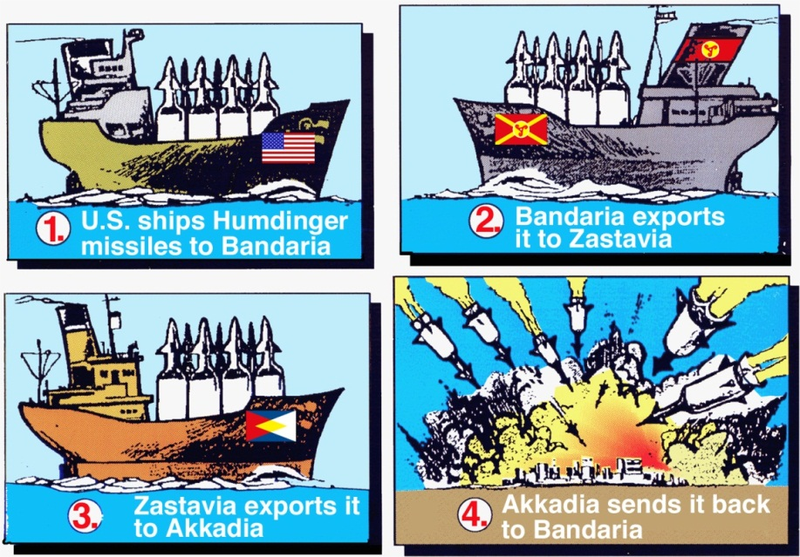
General Concept #1: Exports
Actual shipment or transmission of items out of the U.S.
Tangible
Intangible (Email, fax, international phone calls)
Re-export
Trans-shipment

Slide 49
General Concept #2: Foreign Person
Specific definition
Any Person who is not:
A U.S. Citizen;
A U.S. Lawful Permanent Resident;
A Person Granted Asylum;
A Refugee;
A Temporary Resident granted amnesty.
Any foreign corporation, business, association, partnership, trust, society or any other entity or group that is not incorporated or organized to do business in the U.S.
Foreign governments, agency or subdivision of foreign governments
Key Point: For export control purposes, a Permanent Resident is considered the same as a U.S. Citizen.

Slide 50
General Concept #3: Deemed Exports
An intangible export in the U.S. to a foreign person
Release or transfer of technology or technical data to a foreign person in the U.S.
Physical export not required
Transfer occurs within U.S.
Deemed to be to the home country of the recipient.
EAR term: “deemed export”
ITAR term: “defense service”
Key Point: The deemed export is the most problematic area for institutions of higher learning and associated research labs.

Slide 51
Primary Regulatory Regimes
EAR – Dual Use items (military & commercial application) & proliferation items.
ITAR – Defense items specifically designed, modified or adapted for military use.
FACR – (various regulations) Financial transactions and services of value
Sanction programs, embargoes, counter terrorism, diamond trading, SDN, narcotics/kingpen, criminal organization, human rights, travel, collaborations.

Slide 52

Control Lists
EAR: Commerce Control List (CCL)
Nuclear Materials, facilities & equipment
Materials, Chemicals, Microorganisms & Toxins
Material Processing
Electronics
Computers
Telecommunications & Information Security
Sensors & Lasers
Navigation & Avionics
Marine (ships, engines, etc).
Propulsion Systems, Space Vehicles & Related Equipment
BIS website: http://www.bis.doc.gov/
EAR CCL: http://www.access.gpo.gov/bis/ear/ear_data.html

Slide 53
Control Lists
EAR: Commerce Control List (CCL)
Positive List – only applies to “things” that meet certain technical parameters
“Dual use” – both military and civilian application
ECCN Structure: Category Product Group
Note: EAR items are not regulated when “operated” within deemed exports limits on fundamental research, but technical information may be.
Exports 101: http://www.bis.doc.gov/licensing/exportingbasics.htm
Brochures: http://www.bis.doc.gov/licensing/bis_eccn.pdf

Slide 54

Control Lists
ITAR: U.S. Munitions List (USML)
I Firearms, Close Assault Weapons and Combat Shotguns
II Guns and Armament
III Ammunition / Ordinance
IV Launch Vehicles, Guided Missiles, Ballistic Missiles, Rockets, Torpedoes, Bombs and Mines
V Explosives and Energetic Materials, Propellants, Incendiary Agents and Their Constituents
VI Vessels of War and Special Naval Equipment
VII Tanks and Military Vehicles
VIII Aircraft and Associated Equipment
IX Military Training Equipment and Training
X Protective Personnel Equipment and Shelters
XI Military Electronics
XII Fire Control, Range Finder, Optical and Guidance and Control Equipment
XIII Auxiliary Military Equipment
XIV Toxicological Agents, Including Chemical Agents, Biological Agents, and Associated Equipment
XV Spacecraft Systems and Associated Equipment
XVI Nuclear Weapons, Design and Testing Related Items
XVII Classified Articles, Technical Data and Defense Services Not Otherwise Enumerated
XVIII Direct Energy Weapons
XIX Reserved
XX Submersible Vessels, Oceanographic and Associated Equipment
XXI Miscellaneous Items
DDTC website:
http://www.pmddtc.state.gov/index.html

Slide 55
Control Lists
ITAR: U.S. Munitions List (USML)
Overly broad & lack of consensus (currently under reform)
Controls three elements of everything subject to USML:
Defense article:
Technical Data relating to the article: Information required for the design, development, production, manufacture, assembly, operation, repair, testing, maintenance, or modification.
Defense Service (know how): Furnishing assistance, (including training) in the design, development, engineering, manufacture, production, assembly, testing, repair, maintenance, modification, operation, demilitarization, destruction, processing or use of a defense article.

Slide 56
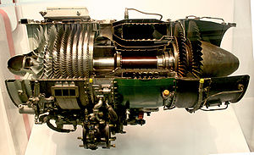

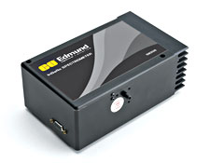
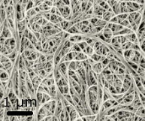
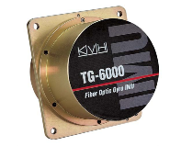
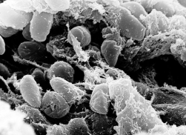
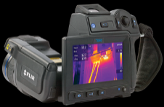
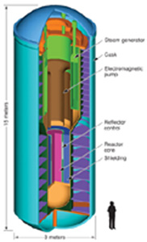


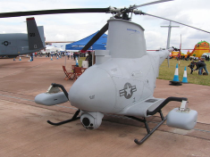
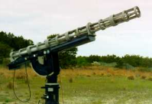
Examples of Controlled Data
Technical data relating to the following (not exhaustive):
Electric power plants (or) certain rockets
EAR
Commerce Control List
Chromatography and spectrometry analytical instruments, x-ray, mass spectrometers
Carbon matrix composites, structures, or laminates meeting specified criteria
Brake pads, rocket tips, re-entry vehicles
Artillery, tanks, ships, aircraft, oil drilling
3A999 Spectrometer
9A991 Turbine Engine
Pathogens, toxins, chemicals, select agents
1C007 Ceramic materials
1C010 Carbon Nanotubes
1C351 Yersinia Pestis
7A002 Gyro
Unmanned Aerial Vehicle, Underwater Vehicle,
ALL rockets, sounding rockets, and launchers
(Super Loki Booster)
Portable nuclear reactor for ship – other controlled by NRC
Satellites, scientific instruments, communication satellites, navigation, experimental, etc.
Hydrazine and derivatives
Cat. VIII - Aircraft
Cat. V - Propellants
Cat. IV - Rockets
Cat. XII - Optics
Cat. XVI Nuclear
Cat. XV - Spacecraft
ITAR
U.S. Munitions List
IR Cameras
(Infrared focal plane arrays)

Slide 57
Exemptions, Exceptions, Exclusions
Each regime has separate “safe harbors”
Exclusion: The activity, product, item, data, etc. is not subject to export control regulations.
Exemption/Exception “An authorization…that allows you to export or reexport under stated conditions…that would other wise require a license….”
Special rules and additional legal requirements.
Alleviates need for license
Case-by-case determination
Key Point: Read the Ashton Carter Memo & NSDD-189

Slide 58
Exclusion to Controls
Specific Qualifying Criteria
Published Information and Software Exclusion of 15 CFR § 734.7 (EAR) and 22 CFR § 120.11 (ITAR) the information is already published and available in the public domain (excluding certain encryption technology and military data not approved for public release, even if already publically available).
Fundamental Research Exclusion of 15 CFR § 734.8 (EAR) and 22 CFR § 120.11(a)(8) (ITAR). “Fundamental research” is defined as “basic and applied research in science and engineering at accredited institutions of higher learning in the U.S. where the resulting information is ordinarily published and shared broadly within the scientific community, as distinguished from research the results of which are restricted for proprietary reasons or specific U.S. Government access and dissemination controls.”
Educational Information Exclusion of 15 CFR § 734.9 (EAR) if the information involved in the research is released by instruction in a catalogue course and associated teaching laboratory located in the territorial borders of the U.S. and the beneficiary is a participant in this capacity, or is enrolled in the course.
Patent Application Exclusion of 15 CFR § 734.10 (EAR) if the information is included in certain patent applications described in Section 734.10 of the EAR or if it is already published or will be published, as described in Section 734.7

Slide 59
Exemptions to Controls
The ITAR
123.4(a) & (b) – Temporary imports
123.16(b) – Exports of parts, components, models
125.4(b)(1) – Technical data exports directed by DOD
125.4(b)(3) – Technical data exports directed by USG agency
125.4(b)(5) – Technical data exports for lawfully exported articles
125.4(b)(7) – Technical data returned to sender
125.4(b)(10) –Technical data disclosed to full-time bona fide regular employees
125.4(b)(11) –Technical data authorized by DTC written exemption
125.4(b)(13) –Publicly available data about Cat XV defense articles
125.5(c) – Plant visits
126.4(a) – Exports by or for USG agency
126.4(c) – Imports/Exports for use by USG agency abroad
126.5 – Canadian Exemptions

Slide 60
Exceptions to Controls
The EAR
740.3 – Limited Value Shipment (LVS)
740.4 – Group B Countries (GBS)
740.5 – Civilian End-use (CVS)
740.6 – Technology & Software under Restriction (TSR)
740.7 – Computers (APP)
740.9 – Temporary Imports, Exports & Reexports (TMP)
Tool of Trade , Exhibition, Broadcast Material, News Media
740.10 – Servicing and Replacement of Parts & Equipment (RPL)
740.11 – Governments, International Organizations & Inspections (GOV)
740.12 – Gift Parcels & Humanitarian Donations (GFT)
740.13 – Technology & Software Unrestricted (TSU)
740.14 – Baggage (BAG)
740.15 – Aircraft & Vessels (AVS)
740.16 – Additional Permissive Reexports (APR)
740.17 – Encryption Commodities, Software & Technology (ENC)
740.18 – Agricultural Commodities (AGR)
740.19 – Consumer Communications Device (CCD) (Cuba Specific)

Slide 61
Objectives
Identify, instruct and guide SPARKS students on appropriately managing export control issues encountered in the university environment.
1
Overview of Export Controls Regulations, Exports & Deemed Exports; Controlled Articles, Technical Data & Services
2
Identifying Export Controlled Research Identifying and negotiating export controlled projects

Slide 62
Export Controls Unrelated to Research
International Travel to certain destinations with certain things
Conference, presentations, field work
Travel with equipment (including laptops, pda’s, data storage devices)
Travel with unpublished or proprietary information
Collaborating with specially designated people in foreign countries
Participation on certain projects
Collaborations outside U.S. with foreign nationals (scholars & students)
Entity List Collaborations
Tangible ITAR USML controlled items on campus
Financial Assistance to certain places / people
Financial assistance to embargoed or sanctioned entities or individuals
Providing assistance/training or professional services to sanctioned/restricted countries

Slide 63
Deemed Exports / Tech Transfer
Criteria triggering additional review
What is being exported?
Where will it be exported?
Who will receive it?
Intended use
What is the technology? (EAR/ITAR)
Foreign Nexus / Collaboration
Entity List
Proprietary, non-public domain, NDA, Secrecy order, publication restriction, etc.
OFAC List (SDN)
Denied Persons (terrorists, SDN’s)
Commercial
Military
Who is funding the project?
Foreign Government / Military
Who are the Participants
Deemed Exports
Both?

Slide 64
Key Areas for Review
Sponsored Programs
Technology Transfer
Military Proposals
Funded Contracts, Grants
SBIR, STTR & DoD/NASA Flow-thru
Certain Non-sponsored activities
Patents / Secrecy Orders
Suspicious contacts
Unsolicited sponsorship requests
Filming requests
Invitations to foreign conferences
Misrepresentations of qualifications
Foreign large dollar donations
Visa applicants & Visitors
H-1B
J-1
“Ghosts”
International Travel
Regulation updated
Certain Countries / Travel Warning
Conferences
Intl Travel Committee
Federal Register / GAO Reports
Rule changes / Bartletts
Equipment
Licensing / tech control plans
Vendors
ITAR Equipment
EAR Deemed Export Threshold
Applications
Commodity Jurisdiction
Registrations
Collaborations
Other
MOU’s & Foreign Collaborations
Agreements, NDA’s, Imports, Cert’s

Slide 65
Identifying Export Controlled Research
- Science & Engineering
EAR or ITAR (recruit PI for this!!)
CFDA Number
MTA, NDA, PIA, MOU
1
Review General
Technologies
8
Agreements
7
Clauses
2
Fundamental Research vs. Deemed Export
FAR / DFAR
Section H
CDRL Distribution Statements other than “A”
“Development, production or use” threshold
Educational, Public Domain, FRE
3
Physical Exports
6
Contractual Issues
Pre-publication approval
Access, dissemination, publication or participation restrictions
What,
Where,
Who
Use
5
Military Research
4
Foreign Travel, Collaboration, or Sponsor
SBIR, STTR, Flow-thru
NASA, DOE, Other
Specifically designed, modified, configured or adapted for military use
Advanced Technology Development
- Certain Foreign Nationals or Foreign Entity Collaboration, particular Denied Entity
- Embargoed / sanctioned countries

Slide 66

Brookings Institution Guidance
Particular to university activities
Do not consider all research or university activities as “fundamental research” or “public domain” just because it involves a university.
Utilizing universities and conducting research on-campus creates a higher likelihood of violations
Avoid co-mingle restricted and unrestricted research
Scavenging of Proprietary and intellectual property is on the rise!
From the Cloud Computing section of the Brookings Institute website:
http://www.brookings.edu/papers/2011/0725_cloud_computing_villasenor.aspx

Slide 67
Countries of Concern
Belarus
Balkans
North Korea
Lebanon
Syria
Cyprus
Iraq
China
Palestine
Iran
Libya
Afghanistan
Niger
Sudan
Burma
Cuba
Liberia
Eritrea
Vietnam
Haiti
Guinea
Yemen
Thailand
Ivory Coast
Somalia
Sri Lanka
Venezuela
Sierra Leone
Indonesia
Sponsors of Terrorism
Congo
Fiji
Arms Embargo
Zimbabwe
FACR Sanctioned
Comprehensive
Limited
List-based
Summary available on Department of State “Country Policies & Embargoes”
http://www.pmddtc.state.gov/embargoed_countries/index.html
REGULATORY COMPLIANCE

Slide 68
Penalties
The Export Administration Regulations
"WILLFUL VIOLATIONS"
University - A fine of up to the greater of $1,000,000 or five times the value of the exports for each violation;
Individual - A fine of up to $250,000 or imprisonment for up to ten years, or both, for each violation.
"KNOWING VIOLATIONS“
University - A fine of up to the greater of $50,000 or five times the value of the exports for each violation;
Individual - A fine of up to the greater of $50,000 or five times the value of the exports or imprisonment for up to five years, or both, for each violation.
Civil (Administrative) Sanctions:
The imposition of a fine of up to $12,000 for each violation, except that the fine for violations involving items controlled for national security reasons is up to $120,000 for each violation.

Slide 69
Penalties
The International Traffic in Arms Regulations
Criminal Sanctions:
University - A fine of up to $1,000,000 for each violation;
Individual - A fine of up to $1,000,000 or up to ten years in prison, or both, for each violation.
Civil Sanctions:
University - A fine of up to $500,000 for each violation;
Individual - A fine of up to $500,000 for each violation.
John Reece Roth:
http://www.fbi.gov/knoxville/press-releases/2012/former-university-of-tennessee-professor-john-reece-roth-begins-serving-four-year-prison-sentence-on-convictions-of-illegally-exporting-military-research-data

Slide 70

Penalties
The Office of Foreign Assets Control
Criminal Sanctions:
University - A fine of up to $1,000,000 for each violation;
Individual - A fine of up to $1,000,000 or up to twenty years in prison, or both, for each violation.
Civil Sanctions:
University - A fine of up to $55,000 for each violation;
Individual - A fine of up to $55,000 for each violation.

Slide 71

Suspicious Contacts
Reportable Issues:
Solicitations for Confidential Information Such as schedules, costs, bid information requests
Development, production locations, partners or other key data
Identify assets by value and importance
Products
Military application or dual-use?
“Intended use” does not matter. Was it designed for the military?
Involves defense contractors – who would buy it?
Cutting-edge technology
Proprietary, trade-secret, patent, secrecy order vs. Public Domain?
Foreign Nexus…
Involvement (visits, un-solicitated contacts, contacts from “Countries of Concern”)
Exports?
Visits or unusual requests for bid
Foreign nationals access to data, hardware, software, etc. in any manner in the U.S.?
Collaboration, manufacturing, offshore procurement, etc.?
Foreign Ownership, Control, or Influence (FOCI)
Front Companies
DSS Counterintelligence Training Materials website:
http://www.dss.mil/isp/count_intell/count_train_mat.html
American Universities’ Culture of Openness Attracts Students and Spies: http://www.bendbulletin.com/apps/pbcs.dll/article?AID=/20120410/NEWS0107/204100389
American Universities Infected by Foreign Spies Detected by FBI
http://www.newsmax.com/Newsfront/spies-at-american-universities/2012/04/08/id/435189

Slide 72
Export Control
Contact Information
Mike Miller Assistant Director for Export Controls
Office of Research & Commercialization
Office of Compliance University of Central Florida University Tower/Research Park 12201 Research Parkway, Suite 501 Orlando, FL 32826 Phone (407) 882-0660
Fax: (407) 823-3299 Email: mjmiller@mail.ucf.edu
UCF Export Compliance Website: http://www.research.ucf.edu/ExportControl
REGULATORY COMPLIANCE

Slide 73
Exploring Research Administration from Concept to Commercialization
Environmental Health & Safety
Laboratory and Research Support Services
Mr. Jose Vazquez, Biosafety Coordinator
Mrs. Renea Carver, Hazardous Materials/Radiation Control Coordinator

Slide 74
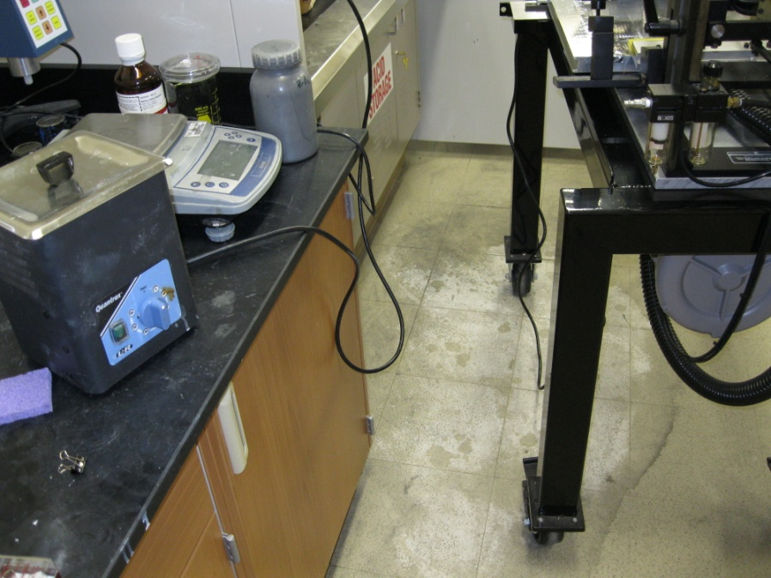
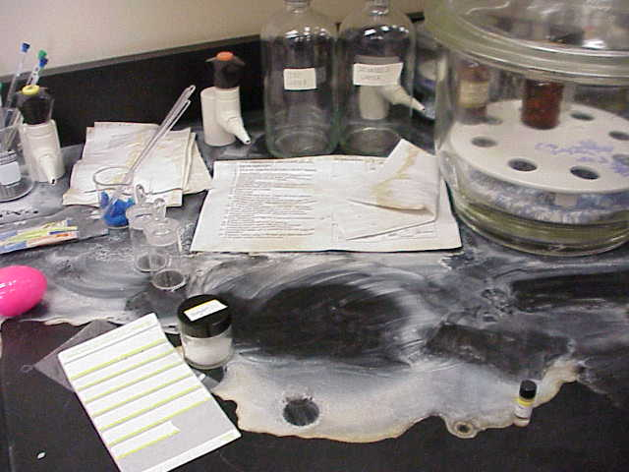
3 Goals
Health & Safety of UCF Community
Laboratory incidents
Cost Avoidance
Maintenance of assigned laboratory space
Compliance
Multiple regulatory agencies
REGULATORY COMPLIANCE

Slide 75
Program Areas
Insurance and Risk Management
Gift-In Kind Donations
Vehicles
Occupational Safety
Accident Investigation and Workers Compensation
Electrical Safety
LASERS
Respiratory Protection
PPE Stations
Building and Fire Code
Evacuation and Power-outage procedures
Permit required facility alterations
Laboratory and Environmental Support
Biological Safety
REGULATORY COMPLIANCE

Slide 76
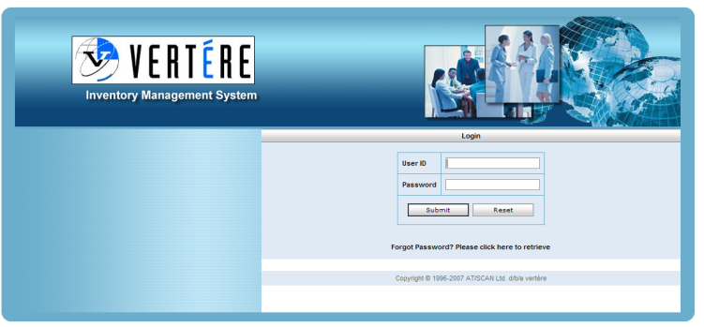
Laboratory Safety
Lab Identification
Laboratory Hazard Signage
New lab assignments and close-outs
Research proposal review/permits
Training
Self-audit, “compliance assistance” meetings with individual labs.
Chemical Inventory
Items barcoded and entered online,
Consumed items “disposed” or “transferred”
Allows for sharing product through ReChem
CFATS, emergency response, etc.
Security

Slide 77
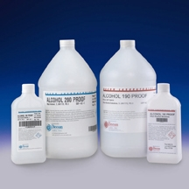

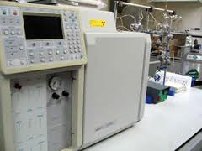
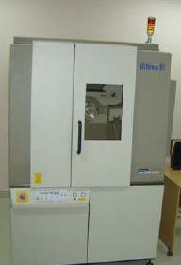

Special Licenses/Issues
ATF
Explosives license
Tax-free alcohol permit
Florida Department of Health
Radioactive Materials (sealed and unsealed)
X-Ray generating equipment
Prescription Drugs
DEA-controlled substances
DOT/IATA
Shipping hazardous materials
Transporting hazardous materials
REGULATORY COMPLIANCE

Slide 78
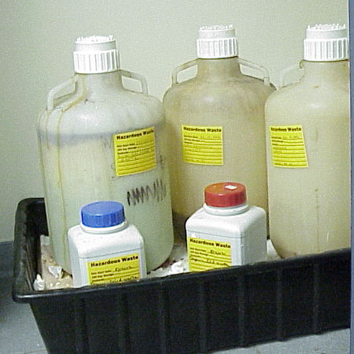
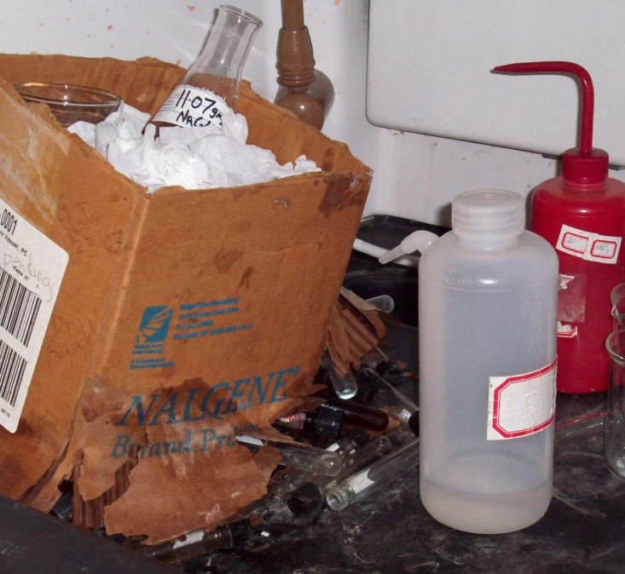
Hazardous Waste
Labs responsible for
Identifying hazardous waste
Labeling, container selection, storage, waste requests.
Cleaning up incidental spills immediately.
EH&S responsible for
Training
Waste collection and disposal
54K FY 2009/2010
Emergency Response
After hours contact information
REGULATORY COMPLIANCE

Slide 79
Biological Safety
Biosafety Levels
Laboratory Practice and Procedure
Safety Equipment
Laboratory Facilities
UCF Research
Institutional Biosafety Committee
Pathogenic agents
rDNA
Biosecurity
REGULATORY COMPLIANCE

Slide 80
ENVIRONMENTAL HEALTH & SAFETY
Questions?
www.ehs.ucf.edu
Regulatory Compliance
Notes:
80

Slide 81
THANKS FOR JOINING US!
Please come to the next session:
AWARD NOTIFICATION & NEGOTIATION
July 11th, 2012
10:00 am – 12:00 pm
REGULATORY COMPLIANCE
June 8, 2011
10:00 am to 12:00 pm
Sponsored Programs Administration Resource & Knowledge Series
Regulatory Compliance

